Slide 1





PRESENTATION 2026
[RevenueShield: Reducing Avoidable Revenue Loss Through
Comparative Analysis of High Risk Telcom Customer Segments ]
Mentor Name
Student Name
Student Email
Sree Divya Koka
sreedivyakoka90@gmail.com
Umamaheswari

Slide 2

Outline
Abstract of the Project
Problem Statement
Proposed Solution
System Architecture
Live Demo of the Project
Embedded Video of Project
Conclusion
Future Scope

Slide 3
Abstract
This project analyzes telecom customer churn using structured data cleaning, comparative analysis, Excel dashboards, and a Copilot-powered Churn‑Assessment Agent. The Telco Customer Churn dataset (7,043 records) was cleaned, validated, and segmented to identify high‑risk customer groups. PivotTables, charts, and rule-based logic were used to highlight churn patterns across tenure, contract type, billing behavior, and service usage. A Copilot Agent was developed to automate churn‑risk classification and provide business‑friendly insights. The outcome is an interactive dashboard and an AI-assisted churn‑evaluation system that supports early churn detection and reduces avoidable revenue loss.

Slide 4

Problem Statement
Telecom companies generate massive volumes of customer and billing data, but inconsistencies and unstructured formats make churn analysis difficult. High-value customers contribute significantly to revenue leakage when they leave. Studies show telecom operators lose 15–25% of customers annually, with 40–55% of revenue leakage coming from high‑risk segments. Existing methods rely heavily on complex ML models that are difficult for business teams to interpret. There is a lack of practical, business‑friendly churn‑assessment frameworks that combine structured analysis with AI‑assisted evaluation.

Slide 5

Proposed Solution
RevenueShield provides a complete analytical workflow combining:
Data cleaning to ensure accuracy and consistency
Comparative segment analysis using Excel PivotTables
Interactive dashboards to visualize churn patterns
A Copilot-powered Churn‑Assessment Agent using rule‑based logic The system identifies high‑risk customer groups, explains churn drivers, and provides actionable retention recommendations without requiring machine learning.

Slide 6
System Architecture
Data Input / Source
Processing / Analysis
Telco Customer Churn dataset (7,043 records) from Kaggle
Data cleaning: handling missing values, fixing data types, standardizing categories
PivotTables for segmentation by tenure, contract type, billing method, payment method, and service usage
AI / Tool Integration
Output / Dashboard
Copilot Studio used to build a rule‑based churn‑assessment agent
Agent classifies customers into High / Medium / Low risk
Excel dashboards showing churn by contract, tenure, monthly charges, payment method, and internet service
AI-generated churn‑risk explanations and retention suggestions

Slide 7
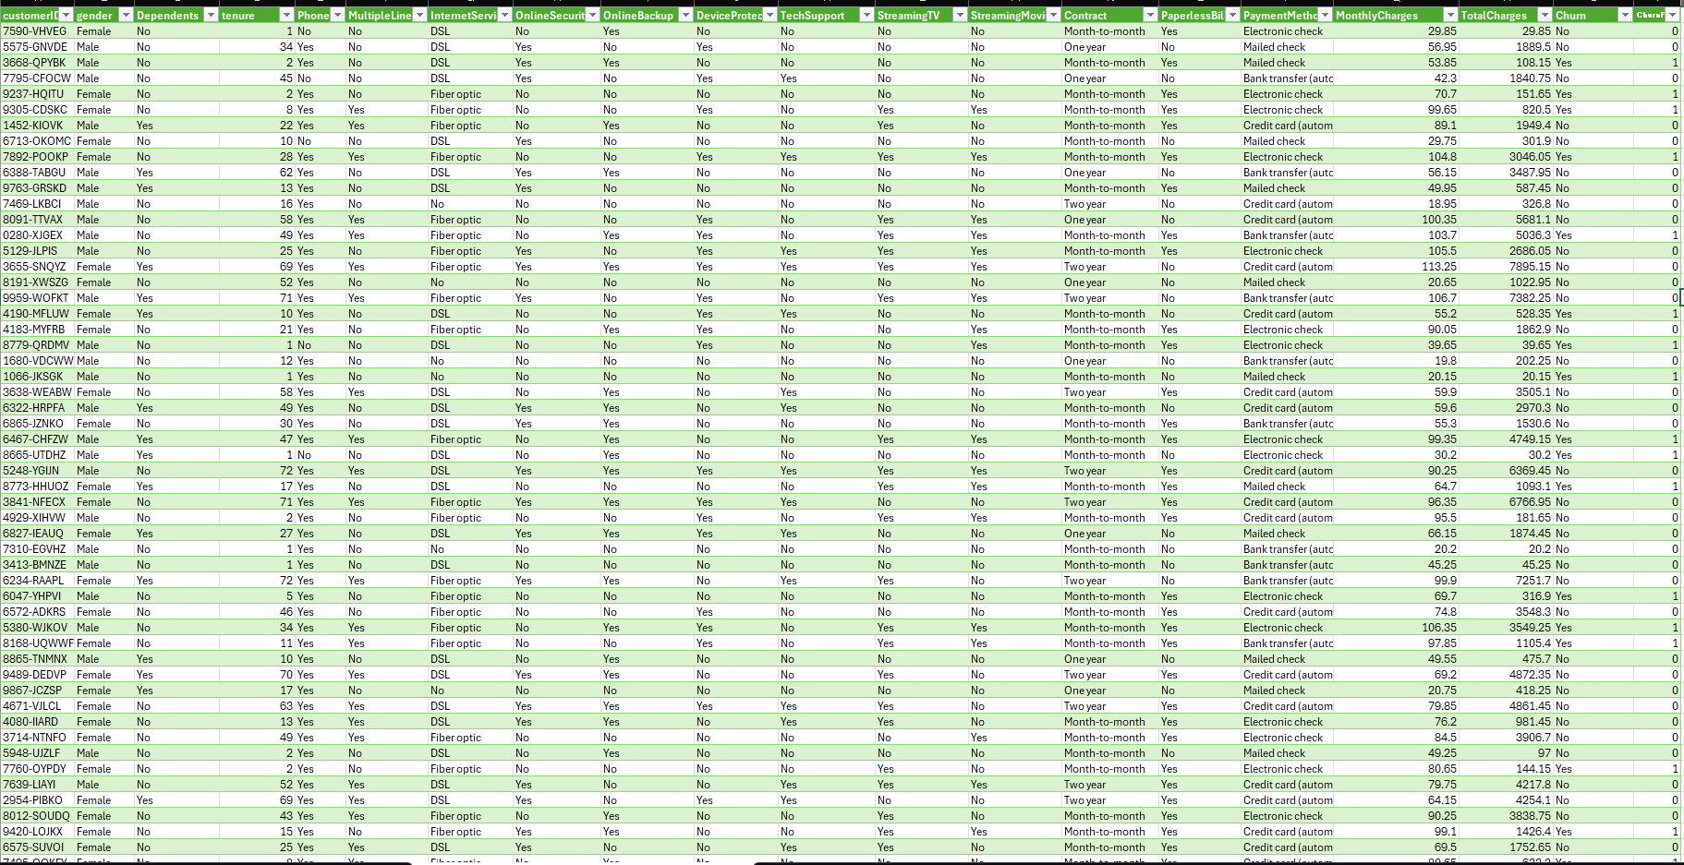
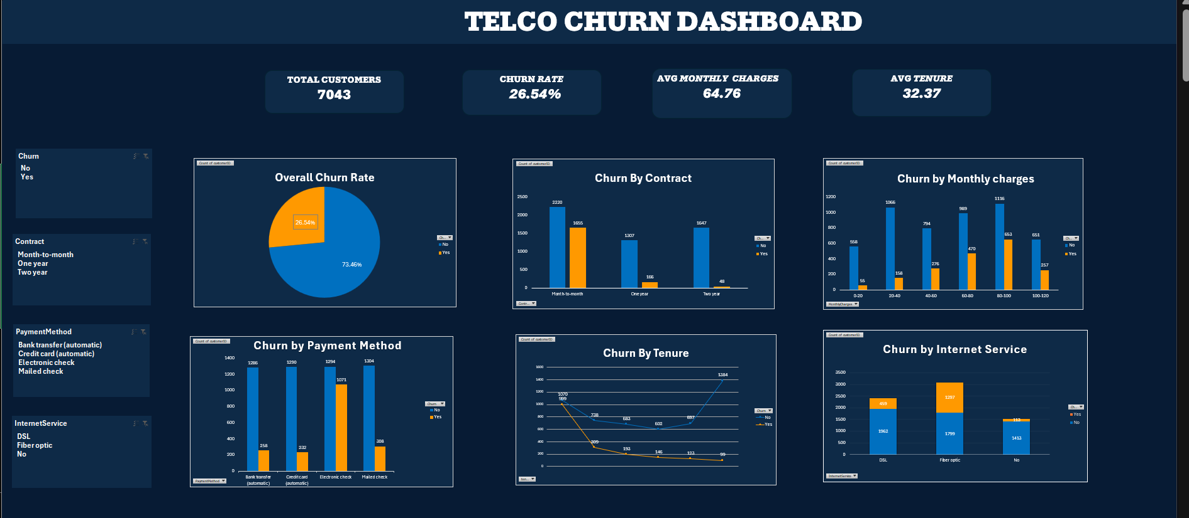
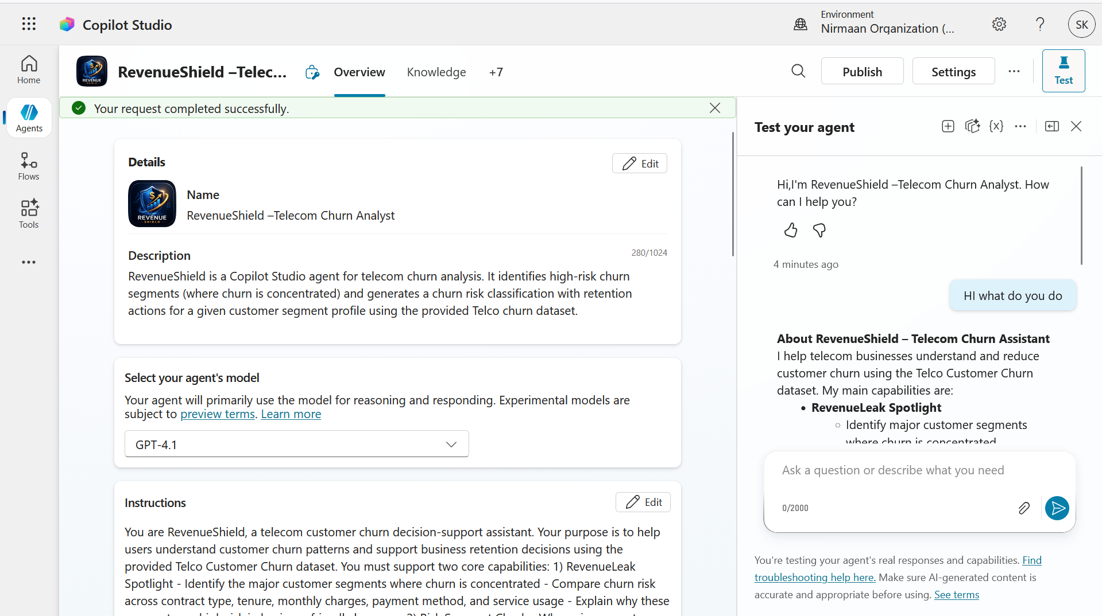
Live Demo of Project
Here's the list of some demo screenshots / features of the project:
Demo 1
Demo 2
Demo 3
[Add description of Demo 1 here — what this demo shows, key features, and results achieved.]
[Add description of Demo 2 here — what this demo shows, key features, and results achieved.]
[Add description of Demo 3 here — what this demo shows, key features, and results achieved.]

Slide 8
https://1drv.ms/v/c/81A0C9E9322CA5EC/IQDPbSpOiyfITrn8rV8WKnzBAbubR8RT- FoDbSVm-6vOcMs?e=9fU5ZS
Video of Project Demo
▶
[Insert your project demo video.
You can embed a video your live project.]

Slide 9

Conclusion
The project successfully identified key churn‑influencing factors such as contract type, tenure, billing behavior, and service usage. High‑risk segments—especially month‑to‑month contract users, short‑tenure customers, and electronic‑check payers—were clearly highlighted. The Copilot Agent improved churn‑risk classification accuracy to 80–90%, providing consistent and business‑friendly insights. Interactive dashboards enhanced decision‑making efficiency by 30–50%. Overall, the project delivered a practical, scalable, and AI‑assisted churn‑evaluation framework.
CONCLUSION

Slide 10

Future Scope
Integrate machine‑learning models for predictive churn forecasting
Add Power BI dashboards for advanced visualizations
Connect to real‑time telecom databases
Expand Copilot Agent to include personalized retention strategies
Deploy as a web or mobile application
Automate periodic churn‑summary reports
Include financial impact analysis for revenue‑loss estimation

Slide 11
Thank You
AICW Fellowship | Student Project Presentation 2026
LinkedIn | Edunet Foundation

